Slide 1



IoT Tech Training – Module Two
Guomin Huang | guhuang@microsoft.com

Slide 2

Agenda
Considerations for Cloud connectivity
Connectivity Patterns
Introduction to IoT Hub
Stream Analytics
Event Processing with Web Jobs
Portal
SDK
Management
Development Tools
Machine Learning

Slide 3



Considerations for Cloud Connectivity

Slide 4
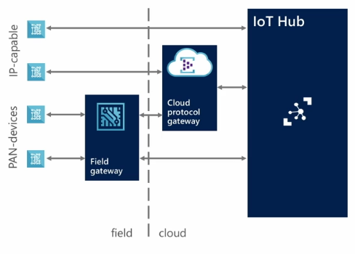
Considerations - Device
Protocols: What protocols are your devices able to communicate with? It needs to be established whether it is supported by the cloud gateway or will require a custom protocol gateway. In addition, what physical networking protocol is it using? Can it support an IP based network?
Platforms: Are your devices compatible with one of the many supported platforms?
Security: Do you require more than server authentication?

Slide 5
Considerations - Cloud
Telemetry: How will you be monitoring your devices? What outputs do you require for analysing data from the hub?
Device Business Logic: How will your devices process commands and software updates?
Management: Devices being provisioned need to be managed correctly by the hub. How will this be maintained and updated?

Slide 6
Considerations - Field Gateways
Communication assistance
Secure data flows edge <-> cloud
Protocol translation
Data buffering
Manage connectivity cost
Data filtering
Data batching/aggregation
Device management
Provisioning
Updates

Slide 7
Introduction to Azure IoT Hub

Slide 8
Solution Architecture
Devices and Data Sources
Data Transport
Device and Event Processing
Presentation
Cloud Gate-way
Data Visualization & Presentation
IP capable devices
Provisioning API
Solution Portal
Device State Store
Agent Libs
Identity & Registry Stores
Existing IoT devices
Stream Event Processor
Agent Libs
Gateway
Storage
Analytics/ Machine Learning
Low power devices
Agent Libs
Control System Worker Role

Slide 9
Solution Architecture – IoT Services
Azure IoT Suite Remote Monitoring
Web/Mobile App
Power BI
Devices
Back end systems and processes
Storage blobs
DocumentDB
C# simulator
IoT Hub
Stream Analytics
Event Hub
Web Jobs
Logic Apps
Azure
Active Directory

Slide 10
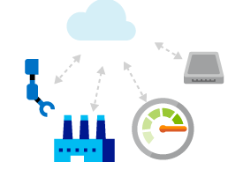
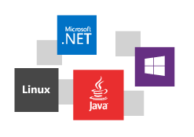
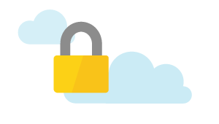
IoT Hub at a glance
Establish bi-directional communication with millions of IoT devices
Work with platforms and protocols that you know
Authenticate per device for security-enhanced IoT solutions
Based on Azure Event Hubs technology; delivering tens of billions of messages per day

Slide 11
What’s supported?
Platforms
Protocols
Languages
Windows, iOS, Android
HTTPS
.NET
Linux/Unix OS Platforms
AMQP
Java
Mbed OS/TI-RTOS/Win Embedded
MQTT
Node.js

Slide 12
Connectivity

Slide 13
Connectivity - Endpoints
Device Endpoints
D2C (device to cloud): send messages to the cloud both as telemetry data, outcome for a received command or request for execution.
C2D (cloud to device): the device receives commands on this endpoint for executing the requested action..
Service Endpoint
Each IoT hub exposes a set of endpoints your application backend can use to communicate with your devices to perform administrative operations.
Only exposed using the AMQP protocol
Device Identity Management Endpoint
Manage device identities (create, retrieve, update, and delete)

Slide 14
Connectivity - Messages
Format
System properties: contains information required by the Hub such as message ID
Application properties: properties the application can access without having to deserialize the body
An opaque binary body (binary, XML, JSON, etc)
Anti-spoofing Properties
To avoid device spoofing in device-to-cloud messages, IoT Hub stamps all messages with the following properties:
ConnectionDeviceId
ConnectionDeviceGenerationId
ConnectionAuthMethod

Slide 15
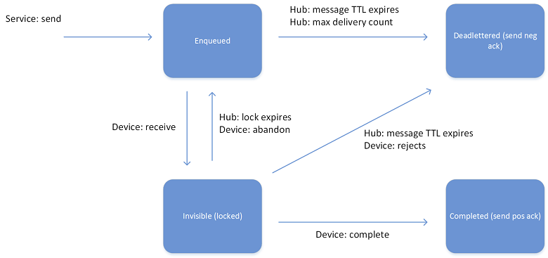
Connectivity - Messages
Lifecycle
At least once delivery guarantee,
Messages are persisted in per-device queues
Devices must explicitly acknowledge completion for message to be removed
This guarantees resiliency against connectivity and device failures.
Feedback
The service can request the delivery of per-message feedback regarding the final state of that message.

Slide 16
Connectivity - Protocols
AMQP
Uses binary protocol which is significantly more compact than HTTP
Supports server push which enables immediate push of messages. This is important if delivery latency is a concern.
AMQP could have problems with traversal if the network does not support non-HTTP protocols
Should be using AMQP wherever possible
HTTP/1
Does not have an efficient way to implement server push, therefore, it is less suitable for field gateway scenarios
Polls the IoT Hub for messages which is less inefficient
Libraries are much smaller that AMQP, ideal for low resource devices
Only use if network or device configuration doesn’t support AMQP

Slide 17
Connectivity - Patterns
Azure IoT Protocol Gateway
A broker able to perform protocol translation for devices not able to support AMQP/HTTP
For example an MQTT adapter is provided to facilitate communication with devices over the MQTT v3.1.1 protocol
Can be deployed on premise as a field gateway
Bridges traffic to the IoT hub over AMQP
Code in Github https://github.com/Azure/azure-iot-protocol-gateway
Field Gateways
Sits in-between your devices and IoT hub, typically close to the devices
Performs an active role of managing access and information flow
Speaks to the IoT hub in a supported protocol

Slide 18
Connectivity Device to Cloud

Slide 19
D2C – Messages
Interface
AMQP and HTTPS device-side endpoint
AMQP service-side endpoint
Device and service SDKs
Compatible with Event Hubs
Partitioned receiver, client check-pointing
Integrations with Azure Stream Analytics, Storm, …
100% compatible with Event Hubs receivers
IoT Hub services for D2C
Millions of simultaneously connected devices
Per-device authentication
Connection-multiplexing:
IoT Hub
Device id
D2C receive endpoint
D2C send endpoint
C2D queue
endpoint
C2D send endpoint
Device …
Device …
IoT Hub management
Device …

Slide 20
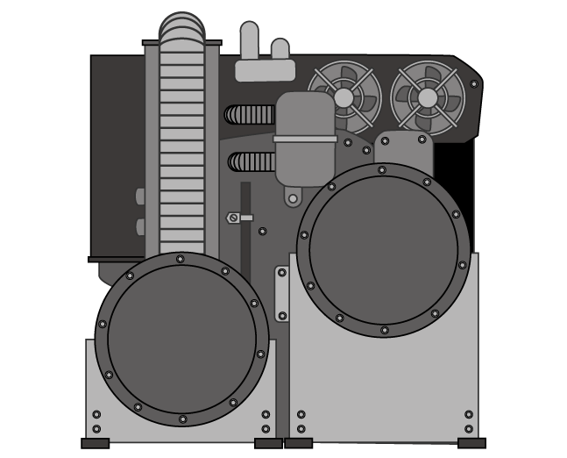
D2C - A sample scenario
Simulated motor
Emits telemetry every second
State machine (Starting→Started→Stopping→Stopped)
Provision device
Device registry to query devices and track provisioning
Device identity and key stored in IoT hub
Device emits telemetry
Event processor receives telemetry and updates portal visualization
Send commands
Portal sends commands to devices
Command lifecycle is stored in device registry
IoT Hub
Event Processor
Device id
D2C receive endpoint
D2C send endpoint
C2D queue
endpoint
C2D send endpoint
Device registry
Command store
Device …
Device …
IoT Hub management
Portal
Device …

Slide 21
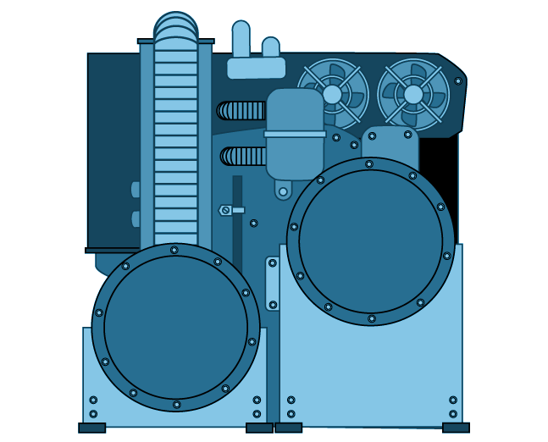

D2C – Consuming Events
Interactive path
Code against SB msg API
Easy event processor implementation
Enable deduplication on Q
Easy routing to different subcomponents
Create SB Q/T based on expected throughput
Use any event processor
Easy to select only “real-time” data.
Storm / Spark
Custom code
Azure Stream Analytics
Run batches from blob
Reuse existing batch code
Easy with Azure Data Factory
Service Bus Q/T
Workers
IoT Hub
Hot path
D2C event router
Cleaning, normalization, logging
Analytics
Cold path
Blob
C&N&L
Analytics

Slide 22
D2C – Consuming Events
Interactive path
Code against SB msg API
Easy event processor implementation
Enable deduplication on Q
Easy routing to different subcomponents
Create SB Q/T based on expected throughput
Use any event processor
Easy to select only “real-time” data.
Storm / Spark
Custom code
Azure Stream Analytics
Run batches from blob
Reuse existing batch code
Easy with Azure Data Factory
Service Bus Q/T
Workers
IoT Hub
Hot path
D2C event router
Cleaning, normalization, logging
Analytics
Cold path
Blob
C&N&L
Analytics

Slide 23
D2C – Consuming Events
Interactive path
Code against SB msg API
Easy event processor implementation
Enable deduplication on Q
Easy routing to different subcomponents
Create SB Q/T based on expected throughput
Use any event processor
Easy to select only “real-time” data.
Storm / Spark
Custom code
Azure Stream Analytics
Run batches from blob
Reuse existing batch code
Easy with Azure Data Factory
Service Bus Q/T
Workers
IoT Hub
Hot path
D2C event router
Cleaning, normalization, logging
Analytics
Cold path
Blob
C&N&L
Analytics

Slide 24
Connectivity Cloud to Device

Slide 25
C2D - Messages
Interface
AMQP and HTTPS device-side endpoint
AMQP service-side endpoint
At-least-once semantics
Durable queued messages (TTL up to 2 days)
Device acknowledges receipt (Send - Receive - Abandon OR Complete)
TTL and receipts
Per-message TTL
Per-message positive and negative receipts
Command lifecycle pattern
Use correlated D2C for responses
Use feedback information to retry
Store command state in command registry
IoT Hub
Device id
D2C receive endpoint
D2C send endpoint
C2D queue
endpoint
C2D send endpoint
Msg feedback and monitoring endpoint
Device …
Device …
IoT Hub management
Device …

Slide 26
C2D - In the sample scenario
Portal
Sends commands to individual motors
Store command in store
Device
Accepts Stop and Start commands
Commands are long-running, when completed/rejected a response is sent
Event Processor
Correlation-id to filter responses from telemetry
Updates outcome on command registry
A message could be sent to a SB T/Q to parallelize work among multiple instances
IoT Hub
Event Processor
Device id
D2C receive endpoint
D2C send endpoint
C2D queue
endpoint
C2D send endpoint
Msg feedback and monitoring endpoint
Device …
Portal
Device …
IoT Hub management
Device …

Slide 27
C2D - Monitoring Connectivity
Feedback Service Endpoint
Device connection/disconnection events
Device error reporting
Event Hub-compatible endpoint
Example Complex device blocking logic
Stream Analytics job evaluates: number of failed connection attempts per device
As a result device can be disabled in IoT Hub
IoT Hub
Device id
D2C receive endpoint
D2C send endpoint
C2D queue
endpoint
C2D send endpoint
Msg feedback and monitoring endpoint
Device …
Device …
IoT Hub management
Device …

Slide 28
Azure Streaming Analytics

Slide 29
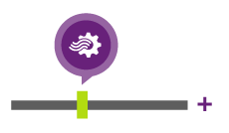
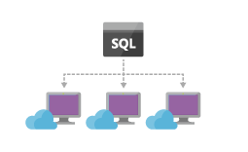
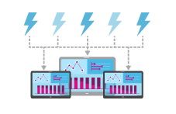
ASA – Benefits
Allows event processing of large volumes of event data at high velocity
Analysis is done as data arrives
Declarative ‘SQL like’ query processing support
High throughput, low latency processing
Real-time stream computation options
Enable rapid development

Slide 30
ASA - Inputs
Data stream inputs
Event Hub: Feed events into Azure in real time, and Stream Analytics jobs can process them
IoT Hub: Stream information collected from connected devices directly into a streaming analytics job
Blob Storage: Can be used as an input source for ingesting bulk data
Reference Data
Static or slow changing used for performing look-ups
Azure Blob Storage is the only supported reference input
Source blobs limited to 50MB in size
Input Data Types
CSV, JSON and Avro Serialized

Slide 31
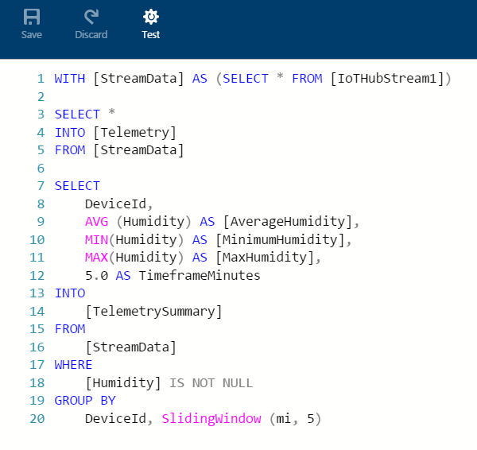
ASA - Queries
Performs transformations and computations over streams of events
Stream Analytics Query Language
Subset of T-SQL syntax
Multiple built-in functions
Supports multiple data types as well as complex
3 types of windowing
Tumbling
Hopping
Sliding
Queries can be created via Azure Portal or via API calls

Slide 32
ASA - Outputs
Multiple options for storing output and viewing analysis results Route to one or more outputs
Flexibility in the consumption and storage of the job output for data warehousing and other purposes
Available Outputs:
SQL Database
Blob Storage
Event Hub
Power BI
Table Storage
Service Bus Queues and Topics
Document DB
Azure Data Lake(Preview)

Slide 33
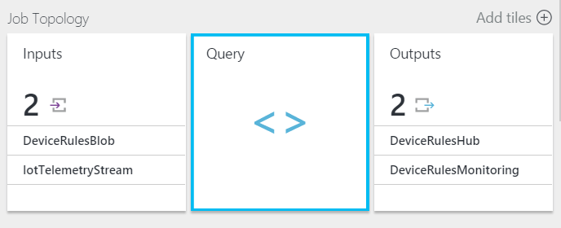
ASA – IoT Suite Usage
Remote Monitoring Solution – Three ASA Jobs
1. Route all telemetry to Blob Storage
Saves all stream data that is used to create telemetry chart
2. Route Command Response and Device Status messages
Identifies and routes Command Response and Device Status messages to an EventHub for further processing
3. Rules
Queries telemetry stream against rules
E.g. Uses 5 minute sliding window to get min/max/average of humidity

Slide 34
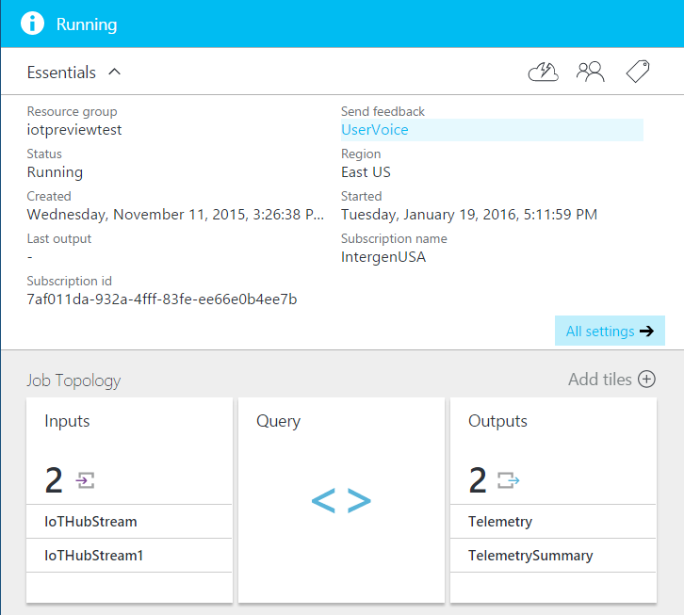
ASA – Management
Portal
Inputs/Queries/Outputs
Scale & Resource Management
Start/Stop Jobs
Other admin options
Code
.NET SDK reference
REST endpoint available
ARM via Azure PowerShell

Slide 35
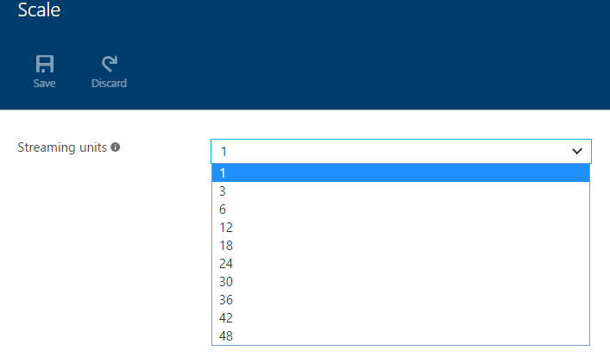
ASA – Scalability
Streaming Units: represent the resources and power to execute an Azure Stream Analytics job
Each streaming unit corresponds to roughly 1MB/second of throughput.
You can select up to your quota in streaming units for a job by using the Azure portal
Number of SU’s used by a job depends on number of steps in a query and partitions defined on each step

Slide 36
Hands on Lab 2

Slide 37
Event Processing with Event Hubs & Web Jobs

Slide 38
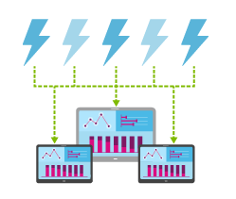
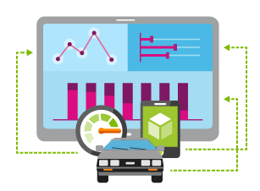
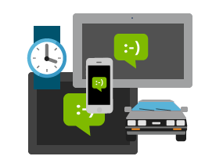
Processing – Event Hubs
Stream millions of events per second
Process events with variable load profiles
Connect millions of devices across platforms

Slide 39
Processing – Event Hubs
Consumer Group 1
Designed to handle event based messaging at a huge scale
Event Hub creates a stream of events to be read
Simple interfaces such as HTTP/AMQP
Internally, uses partitioning pattern to deal with bursts of messages and to retain for longer
Consumer Groups:
Allows receivers to read the stream concurrently but at their own rate
Receivers manage their own pointer to a location in the stream
Event Hub
Sender
Message Stream
Sender
Sender
Consumer Group 2

Slide 40
Processing – Comparison
Azure Service Bus
Relay
NAT and Firewall Traversal Service
Request/Response Services
Queue
Transactional Cloud Broker
High-Reliability Messaging
Topic
Transactional Message Distribution
Up to 2000 subscriptions per Topic
Notification Hub
High-scale Notification Distribution
Mobile push notification services
Event Hub
Collection of Event Streams
Deals with Volume/Velocity/Variety

Slide 41
Processing – Event Processor Model
IEventProcessor
Event Processor Host
Azure Event Hub
Direct
Receivers
> 1M Producers > 1GB/sec Aggregate Throughput
Consumer Group(s)
Partitions
Event Producers
PartitionKey
Hash
AMQP 1.0
Credit-based flow control
Client-side cursors
Offset by Id or Timestamp
Throughput Units:
1 ≤ TUs ≤ Partition Count
TU: 1 MB/s writes, 2 MB/s reads
Up to 32 partitions via portal, more on request

Slide 42
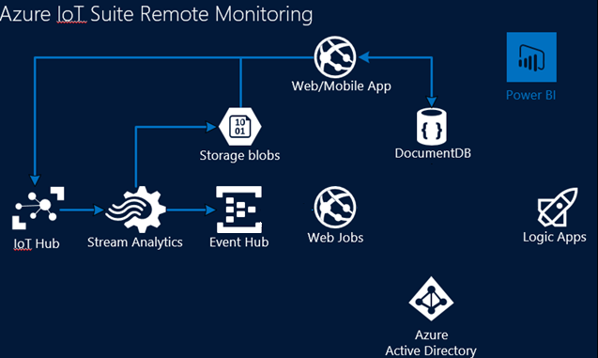
Processing – IoT Suite Usage
Remote monitoring solution
Device Event Processor
Feeds events into Web/Mobile apps
Feeds into logic apps
Device schema updates into DocDB
Located in EventProcessor.WebJob in source

Slide 43
Portal

Slide 44
Portal - Solution Overview
Each preconfigured solution implements a common IoT scenario and is a complete, end-to-end implementation including Portal UI
Complete source code available from GitHub repository to customize and extend the solution
Technologies
Visual Studio 2015
C# Asp.NET MVC 5 Dashboard
JQuery
Moment.js
Azure and IoT SDKs
Autofac Dependency Injection
Json.NET

Slide 45
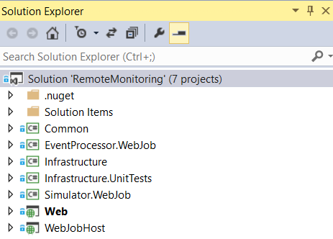
Portal - Solution Source Code
Common
Classes that are common throughout the solution
Contains helpers and utility classes
Sample data generator
EventProcessor.WebJob
Handles events from devices
Forwards to back-end services or RM dashboard
3 Processor hosts
Event
Action
Message Feedback
Projects in Remote Monitoring solution

Slide 46
Portal - Solution Source Code
Infrastructure
APIs and application logic to support telemetry and device operations
Handles 4 main infrastructure components:
Business Logic
Exceptions
Models
Repositories
Infrastructure.UnitTests
Contains multiple tests to ensure integrity of Infrastructure project
Device Schema/Data/Filter/Sample Data tests

Slide 47
Portal - Solution Source Code
Simulator
Simulates one or more devices that send data to the IoT Hub for testing and troubleshooting
Runs as an Azure Web Job and data picked up by Event processor
Uses mock data to imitate real-world devices
Web
MVC 5 Web App dashboard
Displays telemetry from Blob storage
Interacts with Azure IoT Hub endpoints
Shows device information
Ability to set Rules and Alerts
WebJobHost
Hosts both Event Processor and Simulator Web Jobs

Slide 48
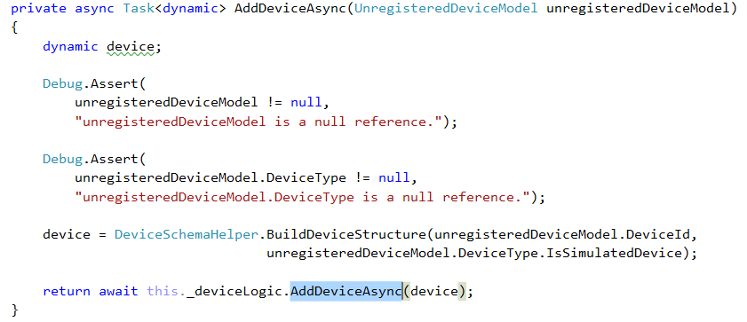
Portal – Device Registry Example
Device CRUD Operations
Device Controller is the top level controller that allows CRUD operations with devices
Interacts with identity registry and device registry (DocDB)
Example: adding a custom device
Device logic validates device
Creates security keys
Add device to identity registry
Add device metadata to device registry
Return the registry repository device
DeviceController.cs – line 273

Slide 49
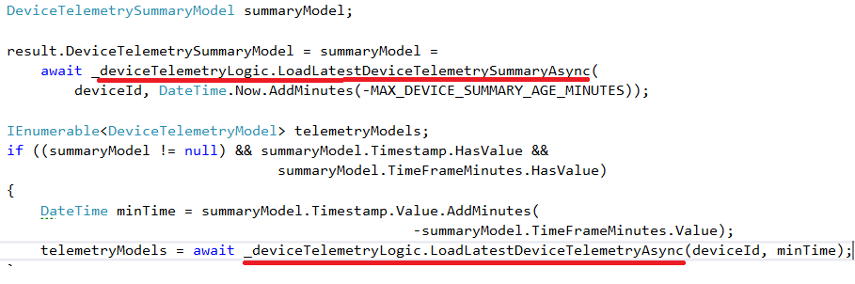
Portal – Data Visualisation Example
Telemetry and Summary History
Raw and summary data values pushed to blob by ASA Job
Client script makes JQuery request for values
The TelemetryApiController is the top level responsible for receiving values from DeviceTelemetryLogic under the infrastructure namespace
Values are parsed into models and returned to controller
Results are rendered onto the dashboard using powerbi- visuals.all.min.js library
TelemetryApiController.cs
Line 97

Slide 50
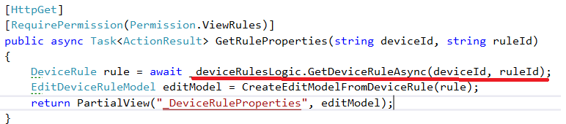
Portal – Rules Example
Retrieving Device Rule Properties
Rules are stored in Azure Table Storage
DeviceRulesController is the top level responsible for amending rules
Properties can be retrieved by providing a device and rule id
DeviceRulesRepository retrieves and parses rule into a model
Rule CRUD operations can be performed from the DeviceRulesRepository
DeviceRulesController.cs - Line 41

Slide 51
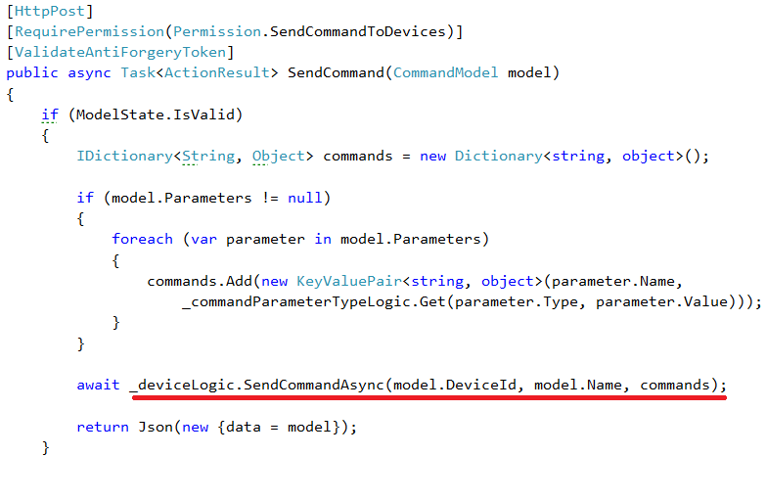
Portal – Command Example
Send Command to Device
Ability to use IoT Hub Service Client to send command to device
Multiple operations such as resend and retrieve command list
DeviceCommandController top level responsible for sending commands
DeviceLogic adds command to history and passes command to repository
IoTHubRepository sends command with basic retry logic
DeviceCommandController- Line 93

Slide 52
Portal – Integration Points
DocumentDB
Used to store device metadata as the device registry
DocDBRestUtility in the Common namespace is responsible for creating, updating and deleting device schema
Blob & Table Storage
Blobs store telemetry data from Azure Streaming Analytics, Tables store Rules
BlobStorageHelper in the Common namespace is used to load Blob items and other heavily used functions
IoT Hub
Used to perform multiple tasks such as device administration and messaging
IoTHubRepository uses the IoT Hub endpoints to manage devices
Authentication
Web project uses OWIN pipeline to Authenticate against WsFederation

Slide 53
Portal – Extend or Bespoke?
Considerations
What physical devices will you be using?
How often will your device schema change?
Are external analytics necessary?
What type of Alarms/Rules/Actions will you require?
How will you display real-time state of devices?
Extension Points
Extending dynamic schema of devices to hold more metadata
Adding additional rules and actions
Displaying more metrics in the dashboard
Creating more commands for your devices

Slide 54
SDK

Slide 55
SDK
SDK and agent libraries easily accessible in GitHub
Cross platform support – choose OS, platform and language
Device support with IP and access control capabilities
Connect IP and non-IP devices via gateway and field protocols
Open source framework to accommodate development of custom agents for devices
Simple and secure D2C and C2D connectivity for messaging, device management and command and control
Multiple OS support - RTOS, Linux, Windows, Android, iOS etc

Slide 56
SDK
Operating Systems Supported
Debian Linux (v 7.5)
Fedora Linux (v 20)
mbed OS (v 2.0)
Raspbian Linux (v 3.18)
Ubantu Linux (v 14.04)
Windows Desktop (7, 8, 10)
Windows IoT Core (v 10)
Windows Server (v 2012 R2)
Yocto Linux (v 2.1)
C Libraries Supported
Debian Linux (v 7.5) HTTPS, AMQP, MQTT
Fedora Linux (v 20) HTTPS, AMQP, MQTT
mbed OS (v 2.0) HTTPS, AMQP
Ubuntu Linux (v 14.04) HTTPS, AMQP, MQTT
Windows Desktop (7,8,10) HTTPS, AMQP, MQTT
Yocto Linux (v 2.1) HTTPS, AMQP

Slide 57
SDKs - Service
Node.js library
Node.js (v 4.1.0) HTTPS
Java library:
Java (v 1.7) HTTPS, AMQP
Java (v 1.8) HTTPS, AMQP
C# libraries supported:
Windows Desktop (7,8,10) HTTPS, AMQP
Windows IoT Core (10) HTTPS
Managed agent code requires .NET framework 4.5

Slide 58
Management

Slide 59
Management - Provisioning
Devices
Device provisioning is the process of adding the initial device data to the stores in your solution
As part of the provisioning process, you might need to initialize device-specific data in other solution store
At a minimum, a solution must store device identities and authentication keys
Azure Resource Manager
You can use ARM to create and manage Azure IoT hubs programmatically
https://msdn.microsoft.com/en-us/library/mt589014.aspx

Slide 60
Management - Provisioning
Identity Registry
Each IoT hub has a device identity registry that you can use to create per-device resources in the service
Does not contain any application metadata
Can be accessed like a dictionary using the deviceId as the key
Does not support expressive queries
Operations:
Create device identity
Update device identity
Retrieve device identity by ID
Delete device identity
List up to 1000 identities
Device provisioning orchestration
IoT Hub
(Identity Registry)
Device Registry (EG. DocDB, SQL, Storage)
Other

Slide 61
Management - Provisioning
Disabling devices
You can disable devices by updating the status property of an identity in the registry
You would typically do this in two scenarios:
For any reason, you consider a device is compromised or has become unauthorized
During a provisioning orchestration process or decommissioning process
Exporting
Exports are long-running jobs that use a customer-supplied blob container to read and write device identity data
You are able to export device identities in bulk from the IoT hubs registry

Slide 62
Management - Provisioning
Device Registry
Provides the ability to add application-specific metadata to your devices
Use a per-device authentication model
The device registry serves as a consistent view of device data
Typically stored in DocDB, SQL DB, or similar
Device provisioning orchestration
IoT Hub
(Identity Registry)
Device Registry (EG. DocDB, SQL, Storage)
Other

Slide 63
Management - Security
Transport Security & Authentication
Various AuthN options including certificates and pre-shared keys
The connection established between devices and IoT Hub is TLS (Transport Layer Security) based
Communication is encrypted
Server is authenticated using its own X.509 certificate sent to the device during hand shaking
Security keys are never sent over the wire- always token/signature based
Custom Authentication Options
Multi-factor Authentication
Active Directory

Slide 64
Security - Authorization
Service-side Communication
RegistryRead and RegistryReadWrite : Grant permissions to the Identity registry
Service connect - Grants access to service-facing comms & monitoring endpoints
Device side communication
Device Connect - Grants access to device-facing communication endpoints
Device Identity Registry - Each device identity has a user-specified deviceId with a set of security credentials and status flag to enable/disable connectivity.

Slide 65
Management - Security
Tokens
Security credentials are never sent over the wire; instead use tokens
Grants access to endpoints by verifying a token against the shared access policies and device identity registry security credentials
SDKs automatically generate tokens when connecting to the service
SharedAccessSignature sig={signature-string}&se={expiry}&skn={policyName}&sr={URL-encoded-resourceURI}
Protocol Specifics
AMQP and HTTP transfer tokens in different ways
HTTP implements authentication by including a valid token in the Authorization request header
AMQP supports both SASL PLAIN and AMQP Claims-Based-Security.

Slide 66
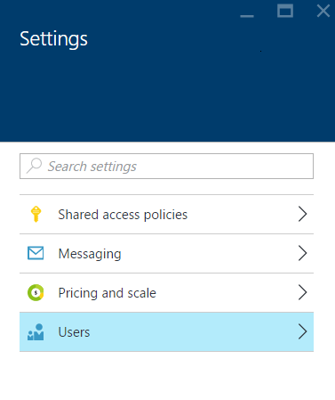
Management - Configuration Options
Management Portal
Shared Access Policies
Add or amend existing policies
Messaging
Change C2D Time To Live and Feedback retention time
Update D2C settings such as partitions in the event hub
Amend Consumer groups
Pricing and Scale
Update pricing and scale tier
Change IoT Hub units
Users
Update Users
Amend roles

Slide 67
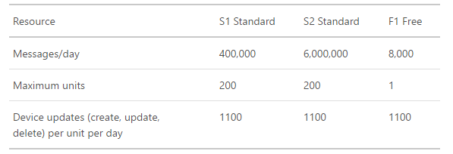
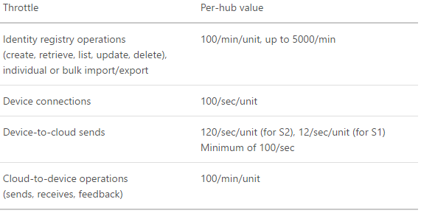
Management - Scale
Quotas
Each Azure subscription can have at most 10 IoT hubs (soft limit)
Each IoT hub is provisioned with a certain number of units in a specific SKU (200 units per hub, soft limit)
The SKU and number of units determine the maximum daily quota of messages that you can send, and the maximum number of device identities in the identity registry
Throttling
Operation throttles returns exceptions if throughput limit is violated for too long
It is possible to increase quotas or throttle limits by increasing the number of provisioned units in an IoT hub

Slide 68
Development

Slide 69
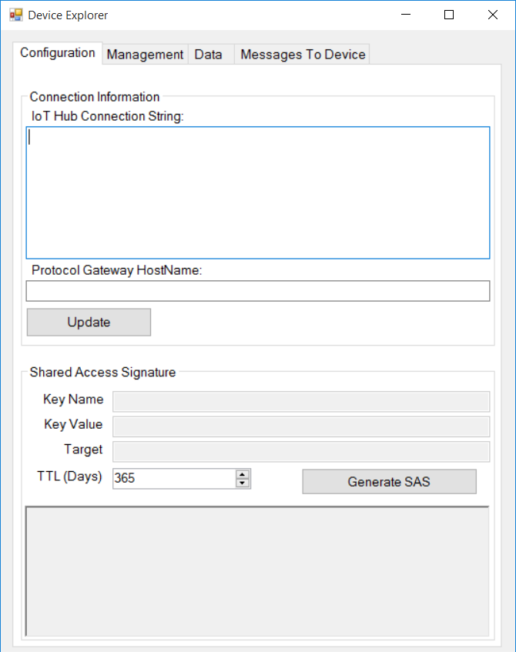
Development - Device Explorer
Allows users to browse and amend devices in the IoT hub
Connection created with connection string and has ability to create SAS keys
Create/List/Update/Delete devices
Monitor data from the IoT hubs event hub so that you can monitor data flowing to the devices
Ability to send messages to the device and display an output response.
Code is in Github; improve and send a pull request…

Slide 70
Portal – Rules Example
Retrieving Device Rule Properties
Rules are stored in Azure Table Storage
DeviceRulesController is the top level responsible for amending rules
Properties can be retrieved by providing a device and rule id
DeviceRulesRepository retrieves and parses rule into a model
Rule CRUD operations can be performed from the DeviceRulesRepository
DeviceRulesController.cs - Line 41

Slide 71
Machine Learning

Slide 72
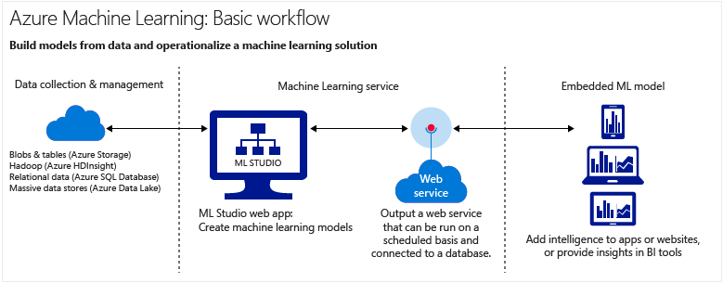
Machine Learning
Azure Machine Learning is a powerful cloud-based predictive analytics service that
makes it possible to quickly create and deploy predictive models as analytics solutions.

Slide 73
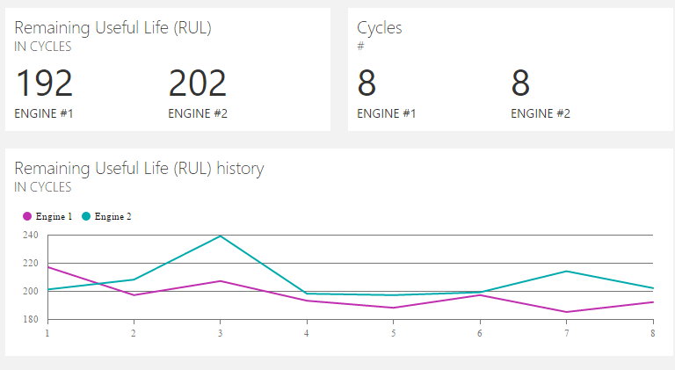
Machine Learning
Predictive Maintenance
Solution comes with Azure ML workspace with experiments for predicting Remaining Useful Life of turbines
Raw sensor values posted to ML endpoint
Event processor web job gets predicted values from ML endpoint
ML endpoint exposes values from the trained model
RUL is displayed on user dashboard

Slide 74
Hands on Lab 3

Slide 75
Github - What’s available?
Remote Monitoring Solution
https://github.com/Azure/azure-iot-remote-monitoring
Predictive Maintenance Solution
https://github.com/Azure/azure-iot-predictive-maintenance
Azure IoT SDKs
https://github.com/Azure/azure-iot-sdks
Windows IoT Core Samples
https://github.com/ms-iot/samples

Slide 76

© 2013 Microsoft Corporation. All rights reserved. Microsoft, Windows, Windows Vista and other product names are or may be registered trademarks and/or trademarks in the U.S. and/or other countries.
The information herein is for informational purposes only and represents the current view of Microsoft Corporation as of the date of this presentation. Because Microsoft must respond to changing market conditions, it should not be interpreted to be a commitment on the part of Microsoft, and Microsoft cannot guarantee the accuracy of any information provided after the date of this presentation. MICROSOFT MAKES NO WARRANTIES, EXPRESS, IMPLIED OR STATUTORY, AS TO THE INFORMATION IN THIS PRESENTATION.

